Slide 1
Class Nine

Slide 2
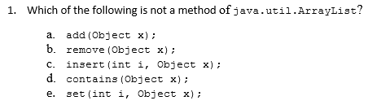
Problem One

Slide 3
Problem One
add(int i, Object x)

Slide 4
How to create & use ArrayLists
ArrayList is defined in the Java API’s java.util package - Just like Scanner
So you must import: import java.util.ArrayList;
To initialize, see syntax:
ArrayList<element-type> NAME = new ArrayList<>();
So:
ArrayList<String> grades = new ArrayList<>();

Slide 5

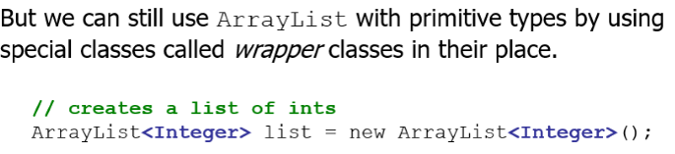
ArrayList Generic Types

Slide 6
ArrayList Generic Types
To get around this problem, Java defines a wrapper class for each of the primitive types:
boolean Boolean
byte Byte
char Character
double Double
float Float
int Integer
long Long
short Short

Slide 7
ArrayList methodS
add(value) | appends value at end of list
add(index, value) | inserts given value at given index, shifting subsequent values right
clear() | removes all elements of the list
indexOf(value) | returns first index where given value is found in list (-1 if not found)
contains(value) | returns true or false, depending on whether the value is found
get(index) | returns the value at given index
remove(index) | removes/returns value at given index, shifting subsequent values left
set(index, value) | replaces value at given index with given value
size() | returns the number of elements in list
toString() | returns a string representation of the list such as "[3, 42, -7, 15]"

Slide 8
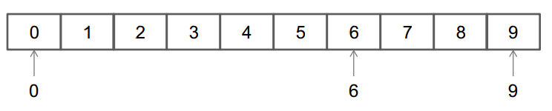
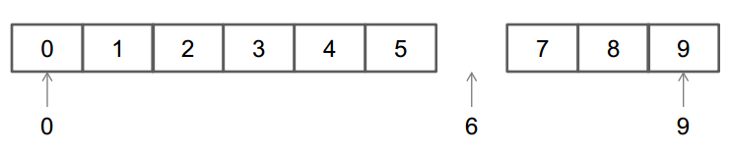
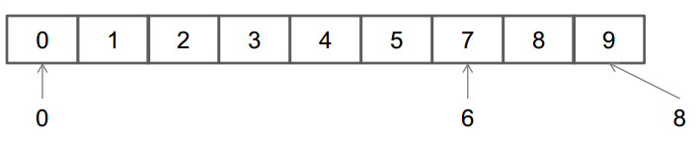
Removing Elements from a list
We need to be careful removing elements from an ArrayList
Remember – when we remove elements, the entire ArrayList shifts into the position of the removed element:
remove(6);

Slide 9
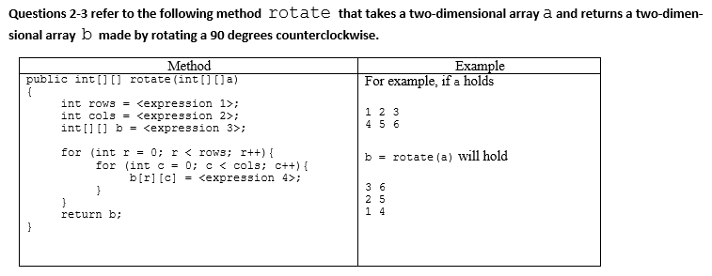
Problem TWO

Slide 10
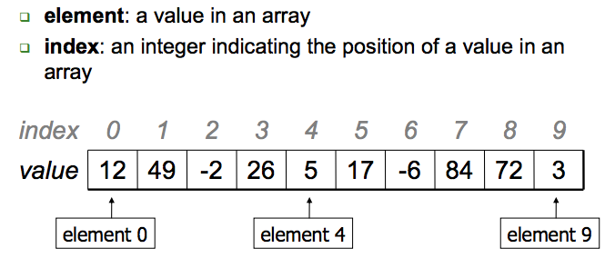
Arrays
An array is an indexed list of values.
You can make an array of any type int, double, String, etc.
All elements of an array must have the same type.
Notes:
An array is a set of values where each value is identified by an index. You can make an array of ints, doubles, or any other type, but all the values in an array have to have the same type.
Syntactically, array types look like other Java types except they are followed by []. For example, int[] is the type “array of integers” and double[] is the type “array of doubles.”
The primary purpose of an array is to facilitate storing and manipulating large quantities of data.
An array stores a sequence of values that are all of the same type.

Slide 11
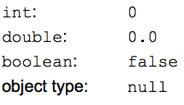
Array Initialization
double [] a = new double[5];
OR
double [] a = {1, 2, 3, 4, 5}
Default values:
The default initial value is:
zero for numbers
false for type boolean
null for String (and other non-primitive type)
Notes:
Use new to allocate memory for an array before accessing any of its elements

Slide 12
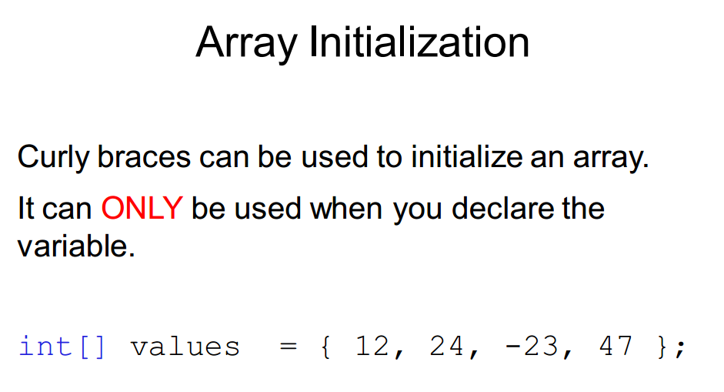

Slide 13
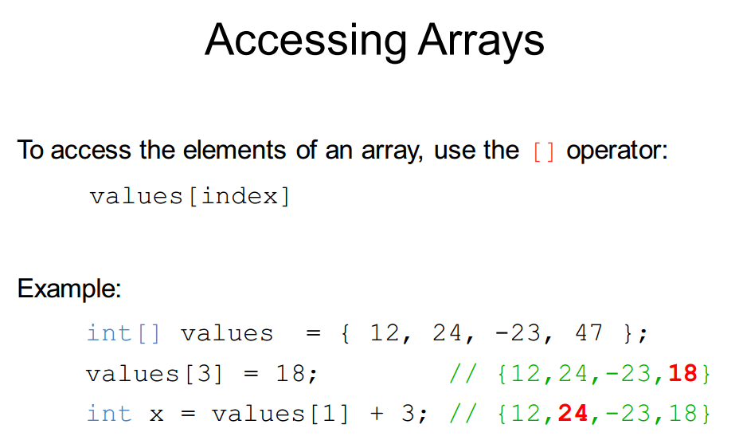
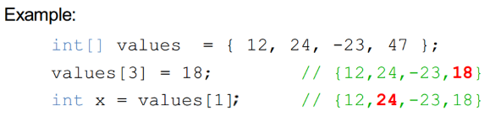

size = values.length;

Slide 14
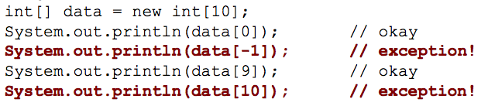
Don’t go out of bounds!
Read or writing any index outside the valid range will throw an ArrayIndexOutOfBoundsException

Slide 15
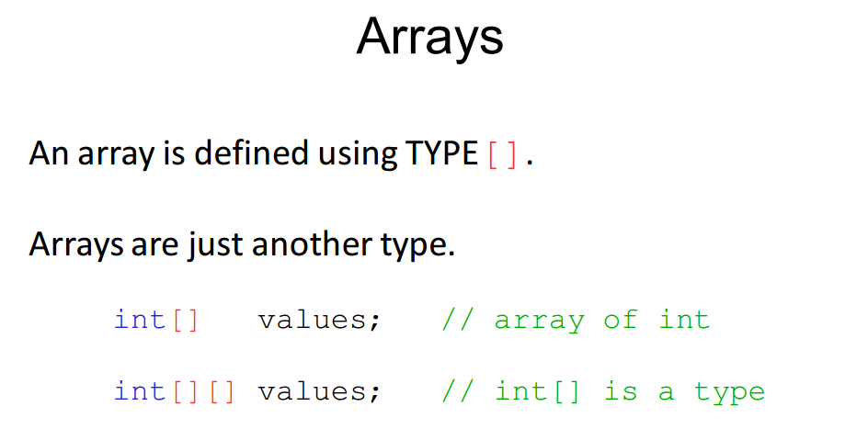

Slide 16
Problem TWO
An array made up of TWO arrays, where each array is of length THREE.
0 1
{1, 2, 3}
{4, 5, 6}
0 1 2
{3, 6}
{2, 5}
{1, 4}
An array made up of THREE arrays, where each array is of length TWO.
1 | 2 | 3
0 1 2

Slide 17
Problem TWO
An array made up of TWO arrays, where each array is of length THREE.
a[0].length;
a.length;
0 1
{1, 2, 3}
{4, 5, 6}
0 1 2
{3, 6}
{2, 5}
{1, 4}
An array made up of THREE arrays, where each array is of length TWO.
1 | 2 | 3
0 1 2

Slide 18
Problem TWO
An array made up of TWO arrays, where each array is of length THREE.
a[0].length; //3
a.length; //2
0 1
{1, 2, 3}
{4, 5, 6}
0 1 2
{3, 6}
{2, 5}
{1, 4}
An array made up of THREE arrays, where each array is of length TWO.
1 | 2 | 3
0 1 2

Slide 19
Problem TWO
An array made up of TWO arrays, where each array is of length THREE.
a[0].length; //3
a.length; //2 new int[rows][cols];
0 1
{1, 2, 3}
{4, 5, 6}
0 1 2
{3, 6}
{2, 5}
{1, 4}
An array made up of THREE arrays, where each array is of length TWO.
1 | 2 | 3
0 1 2

Slide 20
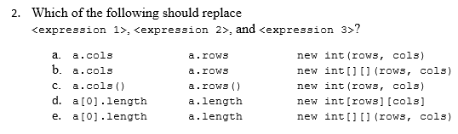
Process of Elimination

Slide 21
Process of Elimination

Slide 22
Problem TWO
An array made up of TWO arrays, where each array is of length THREE.
a[0].length; //3
a.length; //2 new int[rows][cols];
0 1
{1, 2, 3}
{4, 5, 6}
0 1 2
{3, 6}
{2, 5}
{1, 4}
An array made up of THREE arrays, where each array is of length TWO.
1 | 2 | 3
0 1 2

Slide 23
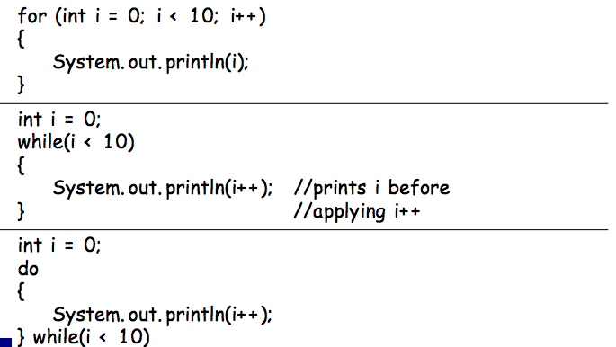
Loops:

Slide 24
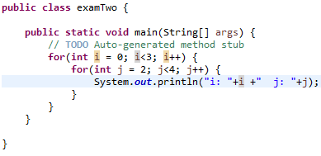
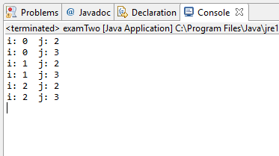
Nesting
Use indenting to emphasize nesting
Indenting helps distinguish between loops (outer, inner)

Slide 25

Problem THREE
r | c | Element | Generic Terms?
0 | 0 | b[0][0] = 3 | a[ 0 ][ 2 ] a[ ][ ]
0 | 1 | b[0][1] = 6 | a[ 1 ][ 2 ] a[ ][ ]
1 | 0 | b[1][0] = 2 | a[ 0 ][ 1 ] b[ ][ ]
1 | 1 | b[1][1] = 5 | a[ 1 ][ 1 ] a[ ][ ]
2 | 0 | b[2][0] = 1 | a[ 0 ][ 0 ] a[ ][ ]
2 | 1 | b[2][1] = 4 | a[ 1 ][ 0 ] a[ ][ ]
Element | in a
1 | a[0][0]
2 | a[0][1]
3 | a[0][2]
4 | a[1][0]
5 | a[1][1]
6 | a[1][2]

Slide 26
Problem THREE
r | c | Element | Generic Terms?
0 | 0 | b[0][0] = 3 | a[ 0 ][ 2 ] a[ c ][r+2]
0 | 1 | b[0][1] = 6 | a[ 1 ][ 2 ] a[ c ][rows-1]
1 | 0 | b[1][0] = 2 | a[ 0 ][ 1 ] a[ c ][r+1]
1 | 1 | b[1][1] = 5 | a[ 1 ][ 1 ] a[c ][rows-1-1]
2 | 0 | b[2][0] = 1 | a[ 0 ][ 0 ] a[ c ][r-2 ]
2 | 1 | b[2][1] = 4 | a[ 1 ][ 0 ] a[c][rows-1-2 ]
Element | in a
1 | a[0][0]
2 | a[0][1]
3 | a[0][2]
4 | a[1][0]
5 | a[1][1]
6 | a[1][2]

Slide 27
Problem THREE
r | c | Element | Generic Terms?
0 | 0 | b[0][0] = 3 | a[ 0 ][ 2 ] a[ c ][rows-1-0]
0 | 1 | b[0][1] = 6 | a[ 1 ][ 2 ] a[ c ][rows-1-0]
1 | 0 | b[1][0] = 2 | a[ 0 ][ 1 ] a[ c ][rows-1-1]
1 | 1 | b[1][1] = 5 | a[ 1 ][ 1 ] a[ c ][rows-1-1]
2 | 0 | b[2][0] = 1 | a[ 0 ][ 0 ] a[ c ][rows-1-2]
2 | 1 | b[2][1] = 4 | a[ 1 ][ 0 ] a[ c ][rows-1-2]
Element | in a
1 | a[0][0]
2 | a[0][1]
3 | a[0][2]
4 | a[1][0]
5 | a[1][1]
6 | a[1][2]

Slide 28
Problem THREE
r | c | Element | Generic Terms?
0 | 0 | b[0][0] = 3 | a[ 0 ][ 2 ] a[ c ][rows-1-r]
0 | 1 | b[0][1] = 6 | a[ 1 ][ 2 ] a[ c ][rows-1-r]
1 | 0 | b[1][0] = 2 | a[ 0 ][ 1 ] a[ c ][rows-1-r]
1 | 1 | b[1][1] = 5 | a[ 1 ][ 1 ] a[ c ][rows-1-r]
2 | 0 | b[2][0] = 1 | a[ 0 ][ 0 ] a[ c ][rows-1-r]
2 | 1 | b[2][1] = 4 | a[ 1 ][ 0 ] a[ c ][rows-1-r]
Element | in a
1 | a[0][0]
2 | a[0][1]
3 | a[0][2]
4 | a[1][0]
5 | a[1][1]
6 | a[1][2]

Slide 29
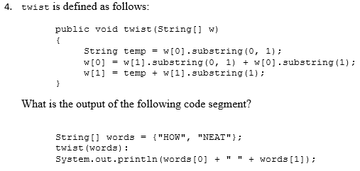
PROBLEM FOUR

Slide 30
Java's primitive types
primitive types: Java's built-in simple data types for numbers, text characters, and logic.
Java has eight primitive types total.
Types that are not primitive are called object types.
We'll use these four primitive types in this class primarily:
Name Description Examples
int integers (whole numbers) 42, -3, 0, 926394
double real numbers 3.14, -0.25, 9.0
char single text characters 'a', 'X', '?', '\n'
boolean logical values true, false
Notes:
We're basically going to manipulate letters and numbers.
We make the integer / real number distinction in English as well. We don't ask, "How many do you weigh?" or, "How much sisters do you have?"
Part of the int/double split is related to how a computer processor crunches numbers. A CPU does integer computations and a Floating Point Unit (FPU) does real number computations.
Why does Java separate int and double? Why not use one combined type called number?

Slide 31
Strings are not a primitive type
We have been using Strings to communicate with the user
“Hello, World!”
As part of review, we are not talking about how to manipulate characters inside of string.

Slide 32
String Concatenation
Putting two strings together, we can use the ‘+’ and we’ve done that before in class and in hw assignments
The String class exports a method called concat() to signify concatenations, but it’s almost never used because we can use +
If you use + with numeric operands, it signifies addition. If at least one of its operands is a string, Java interprets + as concatenation. When it is used in this way, Java performs the following steps:
If one of the operands is not a string, convert it to a string by applying the toString method for that class.
Apply the concat method to concatenate the values.

Slide 33
String Concatenation
public class JavaStringConcat {
public static void main(String args[]){
/*
* String concatenation can be done in several ways in Java.
*/
String str1 = "Hello";
String str2 = " World";
//1. Using + operator
String str3 = str1 + str2;
System.out.println("String concat using + operator : " + str3);
}
}
Output of Java String concat example would be:
String concat using + operator : Hello World

Slide 34
Extracting Substrings
The substring method makes it possible to extract a piece of a larger string by providing index numbers that determine the extent of the substring.
str.substring(i1, i2);
where i1 is the first index position in the desired substring and i2 is the index position immediately following the last position in the substring.
If you only specify the first index, then substring goes until the end of the string:
str.substring(i1);

Slide 35
Extracting Substrings
Example: from “Hello, World!” if you wanted to select the substring "ell“, you would make the following call:
str.substring(1, 4);
Example: from “Hello, World!” if you wanted to select just “World!”, you would make the following call:
str.substring(7); //goes till the end of string
OR
str.substring(7, 13)

Slide 36
Checking Strings for Equality
Many applications will require you to test whether two strings are equal, in the sense that they contain the same characters.
Although it seems natural to do so, you cannot use the == operator for this purpose. While it is legal to write
if (s1 == s2) {…}
The if test will not have the desired effect.
== checks whether the objects are identical, aka does the reference in memory point to the same address (which would be true for primitive types)
To check if two strings are equal:
if( s1.equals(s2) ) {…}

Slide 37

Searching a String
Java’s String class includes several methods for searching within a string for a particular character or substring.
The method indexOf takes either a string or a character and returns the index within the receiving string at which the first instance of that value begins.
If the string or character does not exist at all, indexOf returns -1. For example, if the variable str contains the string "hello, world":

Slide 38
PROBLEM FOUR

Slide 39
PROBLEM FOUR
“HOW” | “NEAT”
w[0] “HOW”
temp “H”
w[1] “NEAT”
w[1].substring(0,1) “N”
w[0].substring(1) “OW”
w[1].substring(1) “EAT”

Slide 40
PROBLEM FOUR
“HOW” | “NEAT”
w[0] “HOW”
temp “H”
w[1] “NEAT”
w[1].substring(0,1) “N”
w[0].substring(1) “OW”
w[1].substring(1) “EAT”
“NOW” + “ “ + “HEAT”

Slide 41
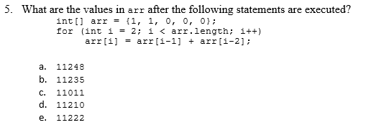

PROBLEM FIVE
1 | 1 | 0 | 0 | 0
0 1 2 3 4
arr.length ➔ 5
i=2 arr[2] = arr[2-1] + arr[2-2]
arr[2] = arr[1] + arr[0]
arr[2] = 1 + 1
arr[2] = 2

Slide 42
PROBLEM FIVE
1 | 1 | 2 | 0 | 0
0 1 2 3 4
arr.length ➔ 5
i=3 arr[3] = arr[3-1] + arr[3-2]
arr[3] = arr[2] + arr[1]
arr[3] = 2 + 1
arr[3] = 3

Slide 43
PROBLEM FIVE
1 | 1 | 2 | 3 | 0
0 1 2 3 4
arr.length ➔ 5
i=4 arr[4] = arr[4-1] + arr[4-2]
arr[4] = arr[3] + arr[2]
arr[4] = 3 + 2
arr[4] = 5

Slide 44
PROBLEM FIVE
1 | 1 | 2 | 3 | 5
0 1 2 3 4
arr.length ➔ 5

Slide 45
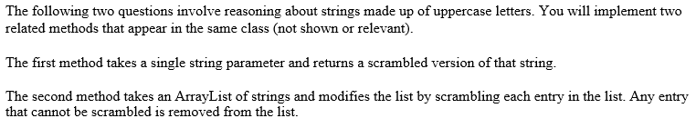
FREE RESPONSE

Slide 46
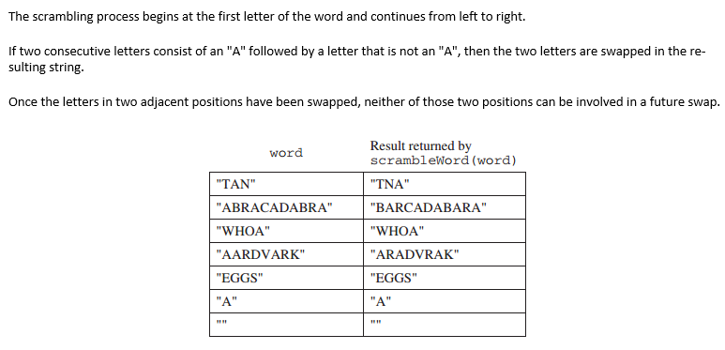
SCRAMBLEWORD

Slide 47
SCRAMBLEWORD
// INTENT: Scramble a word by swapping all letter pairs // beginning with “A”
// 1. Go through every letter in word
// 2. if “A” is followed by not “A”, swap letters
// 3. return word
Notes:
import java.util.ArrayList;
import java.util.List;
class examTwo {
public static void main (String[] arguments) {
System.out.println("TAN -> "+scrambleWord("TAN"));
System.out.println("ABRACADABRA -> "+scrambleWord("ABRACADABRA"));
System.out.println("WHOA -> "+scrambleWord("WHOA"));
System.out.println("AARDVARK -> "+scrambleWord("AARDVARK"));
System.out.println("EGGS -> "+scrambleWord("EGGS"));
System.out.println("A -> "+scrambleWord("A"));
System.out.println(scrambleWord(""));
ArrayList<String> words = new ArrayList<String>();
words.add("TAN");
words.add("ABRACADABRA");
words.add("WHOA");
words.add("APPLE");
words.add("EGGS");
System.out.println("LIST:");
System.out.println(scrambleOrRemove(words).toString());
}
public static ArrayList<String> scrambleOrRemove(ArrayList<String> wordList){
// INTENT: Modify list by replacing each word with scrambled // version and removing any word unchanged by scrambling
int index = 0;
// 1. for each word
while (index < wordList.size()){
String word=wordList.get(index);
String scrambled=scrambleWord(word);
if (word.equals(scrambled)){
// 2. if scrambled word equals original word, then remove
wordList.remove(index);
}
else {
// 3. else replace word in list with scrambled word
wordList.set(index,scrambled);
index++;
}
}
return wordList;
}
public static String scrambleWordWhile(String word){
// INTENT: Scramble a word by swapping all letter pairs beginning with “A”
char[] wordCharArray = word.toCharArray();
int currentLetterIndex = 0;
// 1. for each letter
while(currentLetterIndex < word.length()-1) {
// 2. if “A” is followed by not “A”
if(wordCharArray[currentLetterIndex] == 'A' && wordCharArray[currentLetterIndex+1] != 'A' ) {
// then swap letters
wordCharArray[currentLetterIndex] = wordCharArray[currentLetterIndex+1];
wordCharArray[currentLetterIndex+1] = 'A';
currentLetterIndex++;
}
currentLetterIndex++;
}
return new String(wordCharArray);
}
public static String scrambleWord(String word){
// INTENT: Scramble a word by swapping all letter pairs beginning with “A”
char[] wordCharArray = word.toCharArray();
// 1. for each letter
for(int currentLetterIndex = 0; currentLetterIndex < word.length()-1; currentLetterIndex++) {
// 2. if “A” is followed by not “A”
if(wordCharArray[currentLetterIndex] == 'A' && wordCharArray[currentLetterIndex+1] != 'A' ) {
// then swap letters
wordCharArray[currentLetterIndex] = wordCharArray[currentLetterIndex+1];
wordCharArray[currentLetterIndex+1] = 'A';
currentLetterIndex++;
}
}
return new String(wordCharArray);
}
public static String scrambleWordString(String word){
// INTENT: Scramble a word by swapping all letter pairs // beginning with “A”
int current = 0;
String result="";
// 1. for each letter
while (current < word.length()-1){
// 2. if “A” is followed by not “A”
if (word.substring(current,current+1).equals("A") &&
!word.substring(current+1,current+2).equals("A")){
// then swap letters
result += word.substring(current+1,current+2);
result += "A";
current += 2;
}
else {
result += word.substring(current,current+1);
current++;
}
}
if (current < word.length()){
result += word.substring(current);
}
return result;
}
}

Slide 48
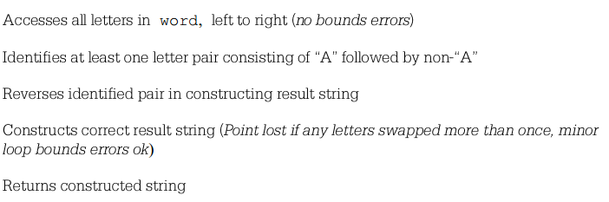
How graded?
35 points total
About 5-10 points for each part that I was looking for:
#1
#2
#3
#4
#5

Slide 49
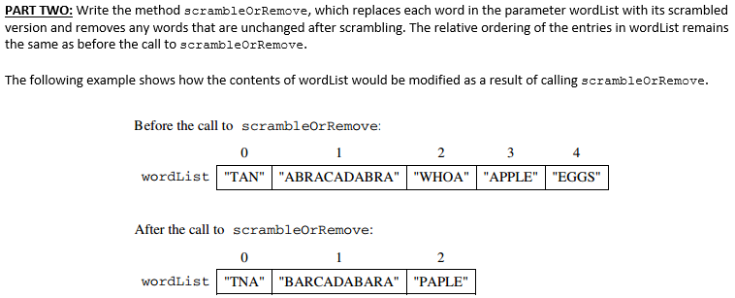
Scramble or Remove

Slide 50
Scramble or Remove
// INTENT: Modify list by replacing each word with scrambled // version and removing any word unchanged by scrambling
// 1. Go through every word in list
// 2. if scrambled word equals original word, then remove
// 3. else if not equal, then replace with scrambled word
// 4. return list

Slide 51
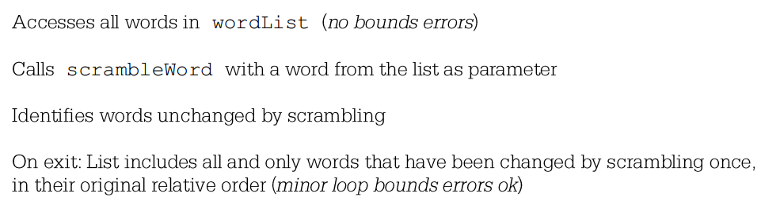
How graded?
40 points total
About 10 points for each part that I was looking for:
#1
#2
#3
#4

Slide 52
COMMON MISTAKES
Didn’t return the word or wordlist
Created a second ArrayList, but wanted you to modify original List
Didn’t call scrambleWord
Switching between Strings and Character Arrays
== & != can be used with characters, but not with strings
Convert character array to string: new String(characterArray)
Confusing Array vs. ArrayList

Slide 53
COMMON MISTAKES Arrays vs. ArrayLists
ACTION | Arrays | ArrayLists
Capacity | Fixed at Creation | Flexible
How to get capacity | grades.length | grades.size()
Getting an element | grades[i] | grades.get(i)
Creation | new double[30] | new ArrayList<Double>()
Setting an element | grades[3] = 90.0; | grades.set(3, 90.0);
For setting an element:
NOT grades.get(3) = 90.0;

Slide 54
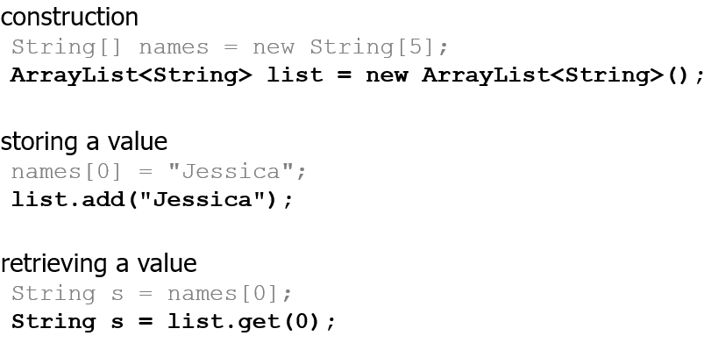
Arrays vs. ArrayLists

Slide 55
Fibonacci Sequence

Slide 56
Example: Fibonacci Numbers
F₀ | F₁ | F₂ | F₃ | F₄ | F₅ | F₆ | F₇ | …
0 | 1 | 1 | 2 | 3 | 5 | 8 | 13 | …
1. The sum of the squares of two consecutive Fibonacci numbers is another Fibonacci number.
2. The sum of the first “n” Fibonacci numbers is one less than F_{n+2}

Slide 57
History of Fibonacci Numbers
The origin of the Fibonacci numbers and their sequence can be found in a thought experiment posed in 1202. It was related to the population growth of pairs of rabbits under ideal conditions. The objective was to calculate the size of a population of rabbits during each month according to the following rules (the original experiment was designed to calculate the population after a year):
1. Originally, a newly-born pair of rabbits, one male and one female, are put in a field.
2. Rabbits take one month to mature.
3. It takes one month for mature rabbits to produce another pair of newly-born rabbits.
4. Rabbits never die.
5. The female always produces one male and one female rabbit every month from the second month on.

Slide 58
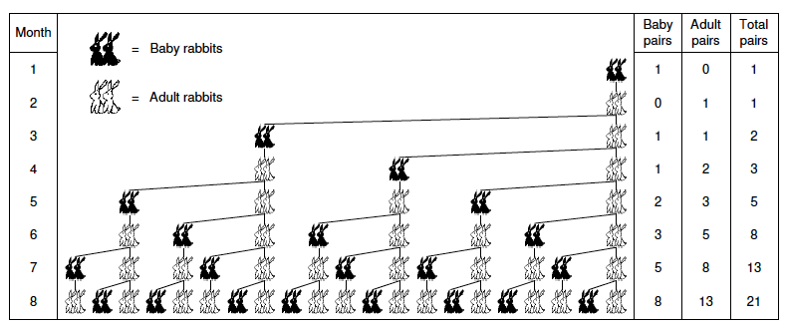
Rabbit Genealogical Tree

Slide 59
Finding the nth term
public static int fibonacci(int n) {
// if it’s the 0th or 1st term then you return 0 or 1
//any term after, you keep adding the last two terms starting with 0 and 1 until you reach nth sum of terms
//return nth sum
}
Notes:
public class Fibonacci {
public static void main(String[] args) {
// TODO Auto-generated method stub
System.out.println(fibonacci(4));
}
private static int fibonacci(int n) {
int term1, term2, termN=0;
if (n <=1)
return n; //F0 = 0 and F1 = 1;
else
{
term1 = 0;
term2 = 1;
for (int i = 2; i <= n; i++)
{
termN = term1 + term2;
term1 = term2;
term2 = termN;
}
return termN;
}
}
}

Slide 60
Recursion
Can simply be thought of as when a method calls on itself

Slide 61
Recursion
recursion: The definition of an operation in terms of itself.
Solving a problem using recursion depends on solving smaller occurrences of the same problem.
recursive programming: Writing methods that call themselves to solve problems recursively.
An equally powerful substitute for iteration (loops)
Particularly well-suited to solving certain types of problems

Slide 62
Why learn recursion?
"cultural experience" - A different way of thinking of problems
Can solve some kinds of problems better than iteration
Leads to elegant, simplistic, short code (when used well)
Many programming languages ("functional" languages such as Scheme, ML, and Haskell) use recursion exclusively (no loops)
A key component of the rest of our assignments!

Slide 63
Recursion’s Three Steps
Decide how to take one step.
Know when to stop.
Break the journey down into the step plus a smaller, similar journey.

Slide 64

Example/Exercise
In a movie theater near the back and you think to yourself, which row am I in?
It’s dark and poor visibility, so you can see only the people right in front of you. And you don’t really want to count.
But you are allowed to ask questions of the person next to you.
How can we solve this problem? (recursively )
How many rows in front of me?

Slide 65
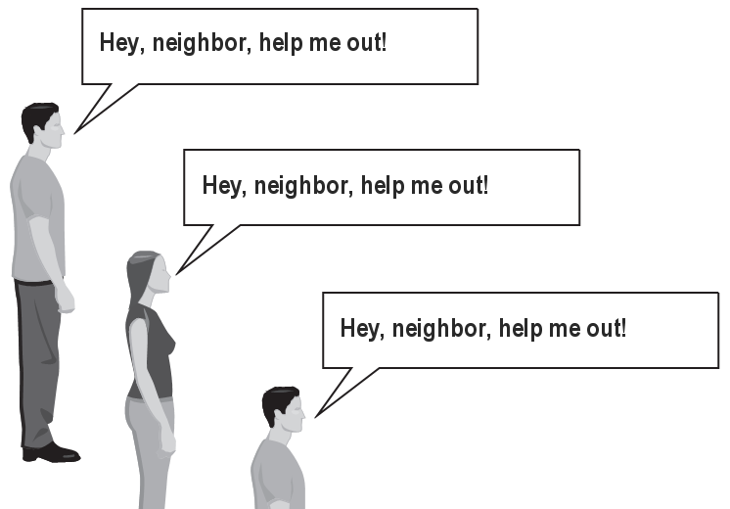
The idea
Recursion is all about breaking a big problem into smaller occurrences of that same problem.
Each person can solve a small part of the problem.
What is a small version of the problem that would be easy to answer?
What information from a neighbor might help me?
SO, what’s the first step?

Slide 66
Recursive algorithm
Number of rows in front of you:
If there is someone in front of you, ask him/her which row they’re in
When they respond with a value N, then you will answer N + 1.
When does it stop?

Slide 67
Recursive algorithm
Number of rows in front of you:
If there is someone in front of you, ask him/her which row they’re in
When they respond with a value N, then you will answer N + 1.
When does it stop?
When you reach the person in the first row, there’s no one in front of them so clearly they would answer that they’re in row 1!

Slide 68
Recursion and cases
Every recursive algorithm involves at least 2 cases:
base case: A simple occurrence that can be answered directly.
recursive case: A more complex occurrence of the problem that cannot be directly answered, but can instead be described in terms of smaller occurrences of the same problem.
Some recursive algorithms have more than one base or recursive case, but all have at least one of each.
A crucial part of recursive programming is identifying these cases.

Slide 69
Recursion in Java
Consider the following method to print a line of * characters:
// Prints a line containing the given number of stars.
// Precondition: n >= 0
public static void printStars(int n) {
for (int i = 0; i < n; i++) {
System.out.print("*");
}
System.out.println(); // end the line of output
}
Write a recursive version of this method (that calls itself).
Solve the problem without using any loops.
Hint: Your solution should print just one star at a time.

Slide 70
A basic case
What are the cases to consider?
What is a very easy number of stars to print without a loop?
public static void printStars(int n) {
if (n == 1) {
// base case; just print one star
System.out.println("*");
} else {
...
}
}

Slide 71
Recursion in Java
Consider the following method to print a line of * characters:
// Prints a line containing the given number of stars.
// Precondition: n >= 0
public static void printStars(int n) {
for (int i = 0; i < n; i++) {
System.out.print("*");
}
System.out.println(); // end the line of output
}
Write a recursive version of this method (that calls itself).
Solve the problem without using any loops.
Hint: Your solution should print just one star at a time.

Slide 72
A basic case
What are the cases to consider?
What is a very easy number of stars to print without a loop?
public static void printStars(int n) {
if (n == 1) {
// base case; just print one star
System.out.println("*");
} else {
...
}
}

Slide 73
Handling more cases
Handling additional cases, with no loops (in a bad way):
public static void printStars(int n) {
if (n == 1) {
// base case; just print one star
System.out.println("*");
} else if (n == 2) {
System.out.print("*");
System.out.println("*");
} else if (n == 3) {
System.out.print("*");
System.out.print("*");
System.out.println("*");
} else if (n == 4) {
System.out.print("*");
System.out.print("*");
System.out.print("*");
System.out.println("*");
} else ...
}

Slide 74
Handling more cases 2
Taking advantage of the repeated pattern (somewhat better):
public static void printStars(int n) {
if (n == 1) {
// base case; just print one star
System.out.println("*");
} else if (n == 2) {
System.out.print("*");
printStars(1); // prints "*"
} else if (n == 3) {
System.out.print("*");
printStars(2); // prints "**"
} else if (n == 4) {
System.out.print("*");
printStars(3); // prints "***"
} else ...
}

Slide 75
Using recursion properly
Condensing the recursive cases into a single case:
public static void printStars(int n) {
if (n == 1) {
// base case; just print one star
System.out.println("*");
} else {
// recursive case; print one more star
System.out.print("*");
printStars(n - 1);
}
}

Slide 76
"Recursion Zen"
The real, even simpler, base case is an n of 0, not 1:
public static void printStars(int n) {
if (n == 0) {
// base case; just end the line of output
System.out.println();
} else {
// recursive case; print one more star
System.out.print("*");
printStars(n - 1);
}
}
There is an art of properly identifying the best set of cases for a recursive algorithm and expressing them elegantly.

Slide 77
Back to Fibonacci
F₀ | F₁ | F₂ | F₃ | F₄ | F₅ | F₆ | F₇ | …
0 | 1 | 1 | 2 | 3 | 5 | 8 | 13 | …
1. The sum of the squares of two consecutive Fibonacci numbers is another Fibonacci number.
2. The sum of the first “n” Fibonacci numbers is one less than F_{n+2}

Slide 78
Back to Fibonacci
F₀ | F₁ | F₂ | F₃ | F₄ | F₅ | F₆ | F₇ | …
0 | 1 | 1 | 2 | 3 | 5 | 8 | 13 | …
How would you think of the Fibonacci problem recursively?
Find the nth term of the Fibonacci sequence.
Decide how to take one step.
Know when to stop.
Break the journey down into the step plus a smaller, similar journey.
Notes:
int fib(int n)
{
if (n == 0)
return 0;
else if (n == 1)
return 1;
else return( fib(n-1) + fib(n-2));
}

Slide 79
The underlying problem with the recursive method is that it performs lots of redundant calculations.
• Example: on a reasonably fast computer, to recursively compute F₄₀ takes almost a minute. A lot of time considering that the calculation requires only 39 additions.
• Example: to compute F₅ F₅
F₄ F₃
F₃ F₂ F₂ F₁
F₂ F₁ F₁ F₀ F₁ F₀
F₁ F₀
It turns out that the number of recursive calls is larger than the Fibonacci number we’re trying to calculate - and it has an exponential growth rate.
• Example: n=40, F₄₀ = 102,334,155
The total number of recursive calls is greater than - 300,000,000
+
+
+
+
+
+
REDUNDANT!!

Slide 80
Still Another Example:
What does the following java method do?
public int whoKnows(int[] x, int n)
{
if (n == 1)
return x[0];
else
return Math.min(x[n-1], whoKnows(x, n-1));
}

Slide 81
Other Exercises

Slide 82
Exercise
Write a recursive method pow accepts an integer base and exponent and returns the base raised to that exponent.
Example: pow(3, 4) returns 81
Solve the problem recursively and without using loops.

Slide 83
pow solution
// Returns base ^ exponent.
// Precondition: exponent >= 0
public static int pow(int base, int exponent) {
if (exponent == 0) {
// base case; any number to 0th power is 1
return 1;
} else {
// recursive case: x^y = x * x^(y-1)
return base * pow(base, exponent - 1);
}
}

Slide 84
Exercise
Write a recursive method isPalindrome accepts a String and returns true if it reads the same forwards as backwards.
isPalindrome("madam") → true
isPalindrome("racecar") → true
isPalindrome("step on no pets") → true
isPalindrome("able was I ere I saw elba") → true
isPalindrome("Java") → false
isPalindrome("rotater") → false
isPalindrome("byebye") → false
isPalindrome("notion") → false

Slide 85
Exercise solution
// Returns true if the given string reads the same
// forwards as backwards.
// Trivially true for empty or 1-letter strings.
public static boolean isPalindrome(String s) {
if (s.length() < 2) {
return true; // base case
} else {
char first = s.charAt(0);
char last = s.charAt(s.length() - 1);
if (first != last) {
return false;
} // recursive case
String middle = s.substring(1, s.length() - 1);
return isPalindrome(middle);
}
}

Slide 86
Exercise solution 2
// Returns true if the given string reads the same
// forwards as backwards.
// Trivially true for empty or 1-letter strings.
public static boolean isPalindrome(String s) {
if (s.length() < 2) {
return true; // base case
} else {
return s.charAt(0) == s.charAt(s.length() - 1)
&& isPalindrome(s.substring(1, s.length() - 1));
}
}

Slide 87
Exercise
Write a recursive method reverseLines that accepts a file Scanner and prints the lines of the file in reverse order.
Example input file: Expected console output:
Roses are red, Are belong to you.
Violets are blue. All my base
All my base Violets are blue.
Are belong to you. Roses are red,
What are the cases to consider?
How can we solve a small part of the problem at a time?
What is a file that is very easy to reverse?

Slide 88
Reversal pseudocode
Reversing the lines of a file:
Read a line L from the file.
Print the rest of the lines in reverse order.
Print the line L.
If only we had a way to reverse the rest of the lines of the file....

Slide 89
Reversal solution
public static void reverseLines(Scanner input) {
if (input.hasNextLine()) {
// recursive case
String line = input.nextLine();
reverseLines(input);
System.out.println(line);
}
}
Where is the base case?

